Slide 1

Fall
4
Integration of Knowledge and Ideas and Geometric Figures and Angles
Stuy Prep
Lesson 26F4
Notes:
Slide designed by Benjamin Xie. Logo designed by Madeleine Villamil.

Slide 2
Homework
Does anyone have questions on 26F3 Homework: Key Ideas and Details and Transformations?
₊✩‧₊˚౨ৎ˚₊✩‧₊ ✮ ⋆ ˚｡⋆｡°✩⋆˚˖°
Notes:
Slide designed by Amy Shrestha and Benjamin Xie. Logo designed by Madeleine Villamil.

Slide 3
argument relevant sufficient reasoning irrelevant evaluate
Fall
4
English Language Arts
Integration of Knowledge and Ideas
Aim: Analyze the development of arguments to determine whether or not a claim has relevant and sufficient evidence.
Do Now: Again: why is it so important to cite evidence?
argument relevant sufficient reasoning irrelevant evaluate
Notes:
Text from English Language Arts Learning Standards. Slide designed by Benjamin Xie.

Slide 4
Development of Arguments
An argument is a position or viewpoint that an author supports using reasoning and evidence. Authors use arguments to persuade readers to agree with their ideas. A strong argument consists of three main components:
.
Thesis: The author's overall position or central argument.
Claims: Specific statements or reasons that support the thesis.
Evidence: Facts, examples, statistics, or other information that support individual claims.
argument relevant sufficient reasoning irrelevant evaluate
Notes:
Standard approximation: 6R8
Slide designed by Sabrina Gao and Benjamin Xie. Logo designed by Madeleine Villamil.
About how an author in the text supports a thesis with claims, and those claims with evidence.

Slide 5
Thesis vs. Claims vs. Evidence
How Arguments Are Structured
THESIS: Schools should provide students with more opportunities for outdoor learning.
Claim 1
Outdoor learning improves students' concentration.
Evidence 1
A study found that students performed better on attention tests after outdoor lessons.
Claim 2
Outdoor learning encourages physical activity.
Evidence 2
Students in outdoor classes spent more time walking and participating in active lessons.
Evidence supports claims, and claims work together to support the thesis.
argument relevant sufficient reasoning irrelevant evaluate
Notes:
Standard approximation: 6R8
Slide designed by Sabrina Gao and Benjamin Xie. Logo designed by Madeleine Villamil.

Slide 6
How Authors Develop Arguments
Authors develop their arguments by:
- Presenting a claim: Introducing a reason that supports their thesis.
- Providing examples: Using specific situations to illustrate an idea.
- Using facts or statistics: Presenting measurable information.
- Explaining cause and effect: Showing how one action leads to a particular result.
- Addressing counterarguments: Recognizing and responding to opposing viewpoints.
- Drawing conclusions: Connecting evidence back to the overall thesis.
SHSAT Tip: Pay attention to how each paragraph contributes to the author's overall argument.
argument relevant sufficient reasoning irrelevant evaluate
Notes:
Standard approximation: 6R8
Slide designed by Sabrina Gao and Benjamin Xie. Logo designed by Madeleine Villamil.

Slide 7
Guided Practice: Identify the Argument
Many schools are considering starting classes later in the morning. Supporters argue that later start times would help students get more sleep and improve their academic performance. In one school district, students reported sleeping an average of 35 minutes longer after the district delayed its school start time. Teachers also reported that fewer students appeared tired during morning classes. These observations suggest that later start times may improve students' readiness to learn.
What is the author's main thesis?
Identify two claims or supporting reasons.
What evidence supports the argument?
How does the author connect the evidence to the thesis?
argument relevant sufficient reasoning irrelevant evaluate
Notes:
Standard approximation: 6R8
Slide designed by Sabrina Gao and Benjamin Xie. Logo designed by Madeleine Villamil.

Slide 8
Relevant and Sufficient Evidence
Evidence must satisfy TWO important requirements:
Relevant Evidence: Information that directly relates to and supports a specific claim.
Sufficient Evidence: Enough convincing information to reasonably support the claim.
Important Distinction
- Relevant evidence answers: "Does this information actually support the claim?"
- Sufficient evidence answers: "Is there enough evidence to justify the claim?"
Evidence can be relevant without being sufficient.
Evaluate whether the AUTHOR provides enough evidence for the AUTHOR'S claim, not just whether the evidence sounds interesting or believable.
argument relevant sufficient reasoning irrelevant evaluate
Notes:
Standard approximation: 7R8
Slide designed by Sabrina Gao and Benjamin Xie. Logo designed by Madeleine Villamil.
The standard is about whether or not a claim within the text (not the student’s claim) is supported by the text; i.e., did the author give enough evidence for their own claim? You can also take this for students’ claims, however. Text can be taken from 2022 Week 4.

Slide 9
Relevant vs. Irrelevant Evidence
Claim: School libraries improve students' reading skills.
Evidence A: Students who regularly borrowed books from the school library showed improvement on reading assessments.
Evidence B: The school library recently purchased new furniture and painted its walls.
Evidence C: Students who participated in library reading programs demonstrated measurable growth in vocabulary.
Which evidence directly supports the claim?
Which evidence is related to libraries but does not support the claim?
Why is mentioning the same topic not enough to make evidence relevant?
argument relevant sufficient reasoning irrelevant evaluate
Notes:
Standard approximation: 6R8
Slide designed by Sabrina Gao and Benjamin Xie. Logo designed by Madeleine Villamil.

Slide 10
Sufficient vs. Insufficient Evidence
Claim: A new after-school tutoring program improves mathematics achievement for all students.
Evidence A: One student improved their mathematics score after attending tutoring.
Evidence B: Among 200 participants, average mathematics scores increased after three months of tutoring.
Evidence C: Students reported that the tutoring sessions were enjoyable.
Which evidence is most convincing?
Why is Evidence A insufficient?
Does Evidence B fully prove the claim about all students?
What additional information would strengthen the argument?
argument relevant sufficient reasoning irrelevant evaluate
Notes:
Standard approximation: 6R8
Slide designed by Sabrina Gao and Benjamin Xie. Logo designed by Madeleine Villamil.

Slide 11
Four Ways Evidence Can Fail
3. Unreliable Evidence
- Comes from questionable or unsupported sources.
- Example: Using an anonymous online comment as proof of a scientific conclusion.
4. Overgeneralized Evidence
- Uses a limited example to support an overly broad conclusion.
- Example: Claiming everyone learns better with music because one student does.
1. Irrelevant Evidence
- Does not directly support the claim.
- Example: Arguing that exercise improves concentration by mentioning that gyms have expensive equipment.
2. Insufficient Evidence
- Provides too little information.
- Example: Claiming all students prefer online learning because three students said so.
argument relevant sufficient reasoning irrelevant evaluate
Notes:
Standard approximation: 6R8
Slide designed by Sabrina Gao and Benjamin Xie. Logo designed by Madeleine Villamil.

Slide 12
How to Evaluate Evidence on the SHSAT
Step 1: Identify the Claim
- What exactly is the author trying to prove?
- Underline important words such as all, most, always, causes, or improves.
Step 2: Identify the Evidence
- What facts, examples, or observations does the author provide?
Step 3: Evaluate Relevance
- Does the evidence directly relate to the claim?
Step 4: Evaluate Sufficiency
- Is there enough convincing evidence to support the strength and scope of the claim?
argument relevant sufficient reasoning irrelevant evaluate
Notes:
Standard approximation: 6R8
Slide designed by Sabrina Gao and Benjamin Xie. Logo designed by Madeleine Villamil.

Slide 13
Guided Practice: Evaluate the Evidence
A principal argues that replacing traditional textbooks with tablets will improve academic achievement. To support this claim, she explains that tablets allow students to access digital resources, watch instructional videos, and complete interactive assignments. She also reports that 90% of students surveyed said they enjoyed using tablets. The principal concludes that tablets will lead to higher examination scores.
What is the principal's main claim?
What evidence does she provide?
Is her evidence relevant?
Is her evidence sufficient?
What additional evidence would strengthen her argument?
argument relevant sufficient reasoning irrelevant evaluate
Notes:
Standard approximation: 6R8
Slide designed by Sabrina Gao and Benjamin Xie. Logo designed by Madeleine Villamil.

Slide 14
Guided Practice: Choose the Strongest Evidence
Claim: A community recycling program has successfully reduced the amount of waste sent to landfills.
Which piece of evidence BEST supports this claim?
A. Residents have expressed enthusiasm about participating in the new recycling program.
B. The community distributed more than 5,000 recycling bins during the program's first year.
C. Municipal records show that the amount of waste sent to landfills decreased by 28% during the program's first year.
D. Community leaders believe that recycling is an important environmental responsibility.
argument relevant sufficient reasoning irrelevant evaluate
Notes:
Standard approximation: 6R8
Slide designed by Sabrina Gao and Benjamin Xie. Logo designed by Madeleine Villamil.

Slide 15
Trick Answers
Too Broad: Makes a claim that goes beyond what the passage supports.
Too Narrow: Focuses on a minor detail rather than the overall argument.
Half-True: Includes accurate information but reaches an unsupported conclusion.
Out of Scope: Introduces information that the passage never establishes.
Reversal: States the opposite of what the author argues.
Extreme Language: Uses words such as always, never, entirely, or everyone without sufficient support.
SHSAT multiple-choice questions often include tempting distractors. This can include:
argument relevant sufficient reasoning irrelevant evaluate
Notes:
Standard approximation: 8R8
Slide designed by Sabrina Gao and Benjamin Xie. Logo designed by Madeleine Villamil.
This is really the focus for this lesson as the previous slides are really just continuing to strengthen last week. Text can be taken from 2022 Week 5

Slide 16
Spot the Trick Answer
Some cities have introduced bike-sharing programs to reduce traffic congestion. These programs allow residents to rent bicycles for short trips rather than relying on cars. In one city, transportation officials reported a modest reduction in car trips downtown after a bike-sharing program was introduced. However, the program had little effect on traffic in neighborhoods farther from the city center.
Which conclusion is BEST supported by the passage?
A. Bike-sharing programs eliminate traffic congestion in cities.
B. Bike-sharing programs can reduce some car travel, although their effects may vary by location.
C. Bike-sharing programs are ineffective outside major cities.
D. Every resident prefers bicycles over cars for short trips.
argument relevant sufficient reasoning irrelevant evaluate
Notes:
Standard approximation: 6R8
Slide designed by Sabrina Gao and Benjamin Xie. Logo designed by Madeleine Villamil.

Slide 17
How to Eliminate Trick Answers
3. Eliminate unsupported choices.
- Cross out answers that exaggerate, contradict, or introduce new information.
4. Compare the remaining choices.
- Choose the answer with the strongest and most direct textual support.
5. Verify your selection.
- Return to the passage and identify the evidence that justifies it.
1. Read the question first.
- Determine whether it asks about an argument, claim, or supporting evidence.
2. Predict the answer before looking at the choices.
- Use the passage to formulate your own response.
argument relevant sufficient reasoning irrelevant evaluate
Notes:
Standard approximation: 8R8
Slide designed by Sabrina Gao and Benjamin Xie. Logo designed by Madeleine Villamil.

Slide 18
scale △ 5 12 13 cross ∠ ≊ parallel ∟
Fall
4
Mathematics
Geometric Figures and Angles
Aim: Use modeling strategies to describe relationships between geometric figures and between angles.
Do Now: What is congruence? What is similarity?
scale △ 5 12 13 cross ∠ ≊ parallel ∟
Notes:
Slide designed by Benjamin Xie.

Slide 19
Scale Drawings
I can’t put a rectangle the size of my room in this slide. But I can put a smaller rectangle and give a scale factor (1 in to 3 ft).
2 in
4.5 in
scale △ 5 12 13 cross ∠ ≊ parallel ∟
Notes:
Standard approximation: NY-7.G.1
Slide designed by Benjamin Xie. Logo designed by Madeleine Villamil.

Slide 20
Scale Drawings
Scale factor: 1 in to 3 ft
Let’s find the area:
2 in(3 ft⁄in) × 4.5 in(3 ft⁄in)
6 ft × 13.5 ft
81 ft²
2 in
4.5 in
scale △ 5 12 13 cross ∠ ≊ parallel ∟
Notes:
Standard approximation: NY-7.G.1
Slide designed by Benjamin Xie. Logo designed by Madeleine Villamil.

Slide 21
Scale Drawings
Be careful when you convert in² to ft²:
2 × 4.5 in = 9 in²
9 in²(3 ft⁄in)² scale factor squared because of the in²
9 in²(9 ft²⁄in²)
81 ft²
2 in
4.5 in
scale △ 5 12 13 cross ∠ ≊ parallel ∟
Notes:
Standard approximation: NY-7.G.1
Slide designed by Benjamin Xie. Logo designed by Madeleine Villamil.

Slide 22
Drawing Triangles
Let’s draw: A triangle with side lengths 2, 2, 2.
scale △ 5 12 13 cross ∠ ≊ parallel ∟
Notes:
Standard approximation: NY-7.G.2
Slide designed by Benjamin Xie. Logo designed by Madeleine Villamil.

Slide 23
Drawing Triangles
Let’s draw: A triangle with side lengths 2, 3, 3.
scale △ 5 12 13 cross ∠ ≊ parallel ∟
Notes:
Standard approximation: NY-7.G.2
Slide designed by Benjamin Xie. Logo designed by Madeleine Villamil.

Slide 24
Drawing Triangles
Let’s draw: A triangle with side lengths 1, 2, 4.
scale △ 5 12 13 cross ∠ ≊ parallel ∟
Notes:
Standard approximation: NY-7.G.2
Slide designed by Benjamin Xie. Logo designed by Madeleine Villamil.

Slide 25
Drawing Triangles
You can’t! Each side connects two points in the most direct way possible. For the sides of length 1 and 2, they can’t connect those two points, even if they take the most direct route.
scale △ 5 12 13 cross ∠ ≊ parallel ∟
Notes:
Standard approximation: NY-7.G.2
Slide designed by Benjamin Xie. Logo designed by Madeleine Villamil.

Slide 26
Drawing Triangles
Let’s draw: A triangle with side lengths 2, 2, 4.
scale △ 5 12 13 cross ∠ ≊ parallel ∟
Notes:
Standard approximation: NY-7.G.2
Slide designed by Benjamin Xie. Logo designed by Madeleine Villamil.

Slide 27
Drawing Triangles
The only way for the shorter sides to connect the endpoints of the longer side is to take the most direct route, overlapping with the longer side. For our purposes, this is not a triangle.
scale △ 5 12 13 cross ∠ ≊ parallel ∟
Notes:
Standard approximation: NY-7.G.2
Slide designed by Benjamin Xie. Logo designed by Madeleine Villamil.

Slide 28
Drawing Triangles
Let’s draw: A triangle with angles 60°, 60°, 60°.
scale △ 5 12 13 cross ∠ ≊ parallel ∟
Notes:
Standard approximation: NY-7.G.2
Slide designed by Benjamin Xie. Logo designed by Madeleine Villamil.

Slide 29
Drawing Triangles
Let’s draw: A triangle with angles 30°, 60°, 90°.
Notice: The sum is 180°.
scale △ 5 12 13 cross ∠ ≊ parallel ∟
Notes:
Standard approximation: NY-7.G.2
Slide designed by Benjamin Xie. Logo designed by Madeleine Villamil.

Slide 30
Drawing Triangles
Let’s draw: A triangle with three right angles.
Notice: The sum is not 180°, so this triangle is impossible.
scale △ 5 12 13 cross ∠ ≊ parallel ∟
Notes:
Standard approximation: NY-7.G.2
Slide designed by Benjamin Xie. Logo designed by Madeleine Villamil.

Slide 31
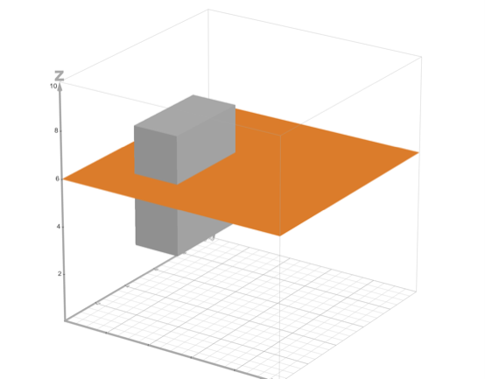
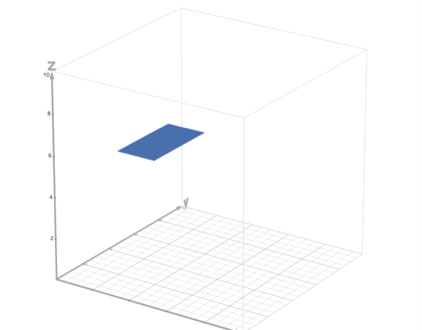
This text is so I can have the cross section appear 4 seconds after
Cross Sections
Let’s slice a 3D shape! This will create a 2D cross section.
Shown: slicing a right rectangular prism parallel to the base.
scale △ 5 12 13 cross ∠ ≊ parallel ∟
Notes:
Standard approximation: NY-7.G.3
Graphs from Desmos. Slide designed by Benjamin Xie. Logo designed by Madeleine Villamil.

Slide 32
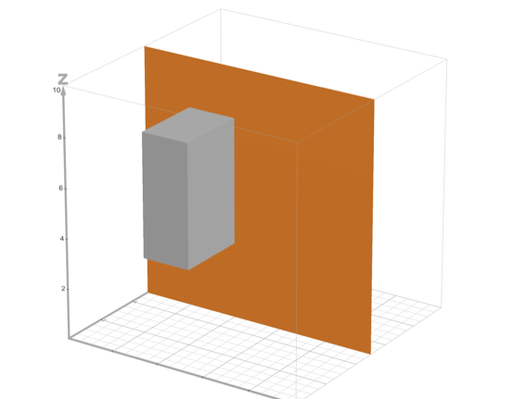
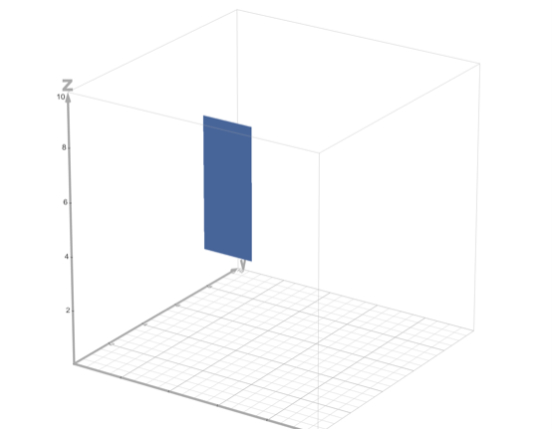
This text is so I can have the cross section appear 4 seconds after
Cross Sections
Shown: slicing a right rectangular prism perpendicular to the base.
scale △ 5 12 13 cross ∠ ≊ parallel ∟
Notes:
Standard approximation: NY-7.G.3
Graphs from Desmos. Slide designed by Benjamin Xie. Logo designed by Madeleine Villamil.

Slide 33
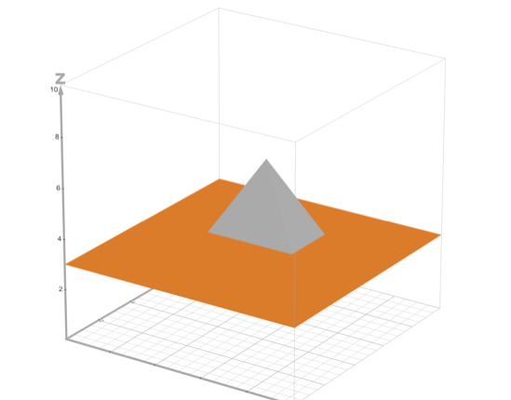
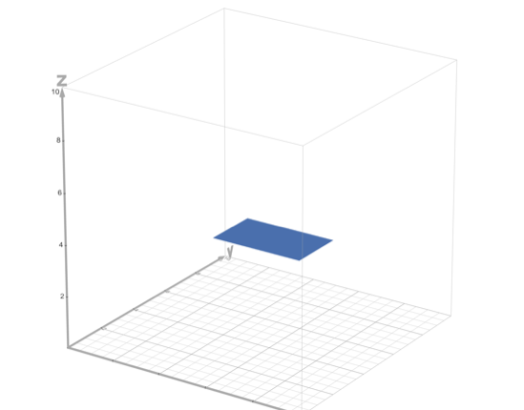
This text is so I can have the cross section appear 4 seconds after
Cross Sections
Shown: slicing a right rectangular pyramid parallel to the base.
scale △ 5 12 13 cross ∠ ≊ parallel ∟
Notes:
Standard approximation: NY-7.G.3
Graphs from Desmos. Slide designed by Benjamin Xie. Logo designed by Madeleine Villamil.

Slide 34
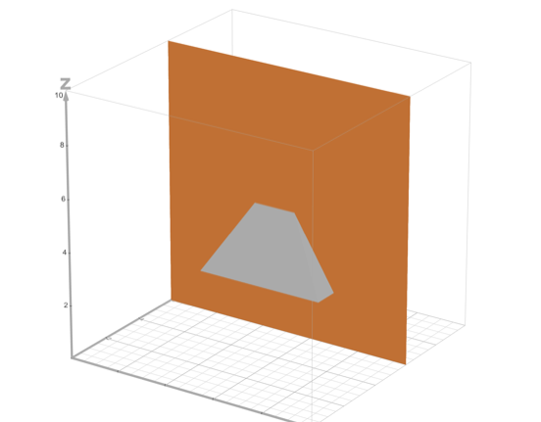
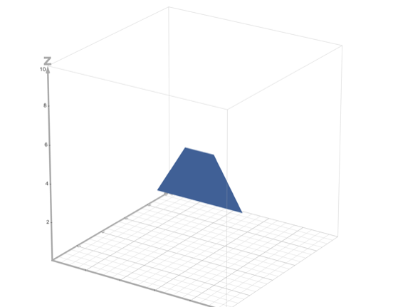
This text is so I can have the cross section appear 4 seconds after
Cross Sections
Shown: slicing a right rectangular pyramid perpendicular to the base.
scale △ 5 12 13 cross ∠ ≊ parallel ∟
Notes:
Standard approximation: NY-7.G.3
Graphs from Desmos. Slide designed by Benjamin Xie. Logo designed by Madeleine Villamil.

Slide 35
Angle Relationships
Adjacent angles share a common vertex and one common side.
∠ADC is a larger angle composed of adjacent angles ∠ADB and ∠BDC, so
m∠ADC = m∠ADB + m∠BDC.
C
B
scale △ 5 12 13 cross ∠ ≊ parallel ∟
A
D
Notes:
Standard approximation: NY-7.G.5
Slide designed by Benjamin Xie. Logo designed by Madeleine Villamil.

Slide 36
Angle Relationships
Complementary angles are two angles, the sum of whose measures is 90°.
(m∠AEC + m∠BEC = 180°)
Two adjacent complementary angles form a right angle.
B
C
A
D
scale △ 5 12 13 cross ∠ ≊ parallel ∟
Notes:
Standard approximation: NY-7.G.5
Text from Catharine Maitner. Slide designed by Benjamin Xie. Logo designed by Madeleine Villamil.

Slide 37
Angle Relationships
C
Supplementary angles are two angles, the sum of whose measures is 180°.
(m∠AEC + m∠BEC = 180°)
One way they can be formed is intersecting a straight line.
A
B
E
scale △ 5 12 13 cross ∠ ≊ parallel ∟
D
Notes:
Standard approximation: NY-7.G.5
Text from Catharine Maitner. Slide designed by Benjamin Xie. Logo designed by Madeleine Villamil.

Slide 38
Angle Relationships
C
Vertical angles are two angles opposite each other when two lines intersect.
Vertical angles are congruent.
(m∠AEC = m∠BED)
A
B
E
scale △ 5 12 13 cross ∠ ≊ parallel ∟
D
Notes:
Standard approximation: NY-7.G.5
Slide designed by Benjamin Xie. Logo designed by Madeleine Villamil.

Slide 39
Angle Relationships
C
We can use angle relationships to do algebra:
If m∠AEC = (7x + 2)° and m∠BEC = 101°, solve for x.
7x + 2 + 101 = 180
7x + 103 = 180
7x = 77
x = 11
A
B
E
scale △ 5 12 13 cross ∠ ≊ parallel ∟
D
Notes:
Standard approximation: NY-7.G.5
Slide designed by Benjamin Xie. Logo designed by Madeleine Villamil.

Slide 40
Angles with Triangles and Parallel Lines
l ∥ m (line l is parallel to line m). What is the relationship between x° and y°?
x°
l
y°
m
scale △ 5 12 13 cross ∠ ≊ parallel ∟
Notes:
Standard approximation: NY-8.G.5
Slide designed by Benjamin Xie. Logo designed by Madeleine Villamil.

Slide 41
Angles with Triangles and Parallel Lines
Translate m onto l. This is possible because l ∥ m.
Now it should be clearer that x + y = 180.
y°
x°
l
scale △ 5 12 13 cross ∠ ≊ parallel ∟
Notes:
Standard approximation: NY-8.G.5
Slide designed by Benjamin Xie. Logo designed by Madeleine Villamil.

Slide 42
Angles with Triangles and Parallel Lines
l ∥ m (line l is parallel to line m). What is the relationship between x° and z°?
x°
l
z°
m
scale △ 5 12 13 cross ∠ ≊ parallel ∟
Notes:
Standard approximation: NY-8.G.5
Slide designed by Benjamin Xie. Logo designed by Madeleine Villamil.

Slide 43
Angles with Triangles and Parallel Lines
Translate m onto l. This is possible because l ∥ m.
Now it should be clearer that x = z.
x°
z°
l
scale △ 5 12 13 cross ∠ ≊ parallel ∟
Notes:
Standard approximation: NY-8.G.5
Slide designed by Benjamin Xie. Logo designed by Madeleine Villamil.

Slide 44
Angles with Triangles and Parallel Lines
D
B
E
Later in the practice, you’ll use this diagram and the fact that line DE ∥ line AC to prove that the sum of the interior angles of a triangle is 180°.
A
C
scale △ 5 12 13 cross ∠ ≊ parallel ∟
Notes:
Standard approximation: NY-8.G.5
Slide designed by Benjamin Xie. Logo designed by Madeleine Villamil.

Slide 45
Angles with Triangles and Parallel Lines
B
Extend line segment AC to form ray AD. This forms exterior angle BCD.
m∠ACB + m∠BCD = 180°
m∠A + m∠B + m∠ACB = 180°
m∠BCD = m∠A + m∠B
A
scale △ 5 12 13 cross ∠ ≊ parallel ∟
C
D
Notes:
Standard approximation: NY-8.G.5
Slide designed by Benjamin Xie. Logo designed by Madeleine Villamil.

Slide 46
Angles with Triangles and Parallel Lines
If you know m∠A and m∠B, then you know m∠C (because sum must be 180°).
So if ∠D ≅ ∠A and if ∠E ≅ ∠B, then ∠F ≅ ∠C and all corresponding angles are congruent.
B
E
D
F
A
C
scale △ 5 12 13 cross ∠ ≊ parallel ∟
Notes:
Standard approximation: NY-8.G.5
Slide designed by Benjamin Xie. Logo designed by Madeleine Villamil.

Slide 47
Angles with Triangles and Parallel Lines
We won’t show every step but you can see how △DEF is the image of △ABC after a dilation and rigid transformations, meaning △ABC ~ △DEF. (AA Similarity)
B
E
D
F
A
C
scale △ 5 12 13 cross ∠ ≊ parallel ∟
Notes:
Standard approximation: NY-8.G.5
Slide designed by Benjamin Xie. Logo designed by Madeleine Villamil.

Slide 48
Fall
4
Thanks for coming! Questions?
Sources: Catharine Maitner
Notes:
Slide designed by Benjamin Xie. Logo designed by Madeleine Villamil.

